Slide 1
NCTU DLP Lab5-Conditional sequence-to-sequence VAE
TA 陳璽存
April 27, 2021
Notes:
‹#›

Slide 2
Outline
Lab Objective
Important Date
Lab Description
Scoring Criteria
Notes:
This course is a graduate-level course, which was first offered in spring term of 2017.
It is instructed by two other professors and me.
Back then, about 55 students were enrolled in this course.
In fact, we had a lot more students hoping to take it.
But, we could accept only 60 of them due to limited GPUs we have.
This course was concluded with a workshop in July this summer, with 26 teams presenting their final projects.
In this workshop, we also invited few experts from the industry to grade the students’ performance.
Some of them were amazed by the diversity of the students’ projects.
‹#›

Slide 3
Lab Objective
In this lab, you need to implement a conditional seq2seq VAE for English tense conversion.
Tense conversion (4 tenses)
E.g. ‘access’ to ‘accessing’, or ‘accessed’ to ‘accesses’
Generative model
Gaussian noise + tense -> access, accesses, accessing, accessed

Slide 4
Important Date
Experiment Report Submission Deadline: 5/11 11:59 a.m
Demo date: 5/11
Zip all files in one file
Report (.pdf)
Source code
name it like「DLP_LAB4_yourID_name.zip」
ex: 「DLP_LAB4_309551009_陳璽存.zip」

Slide 5
Lab Description
To understand CVAE
Reparameterization trick
Log variance
KL lost annealing
Condition

Slide 6
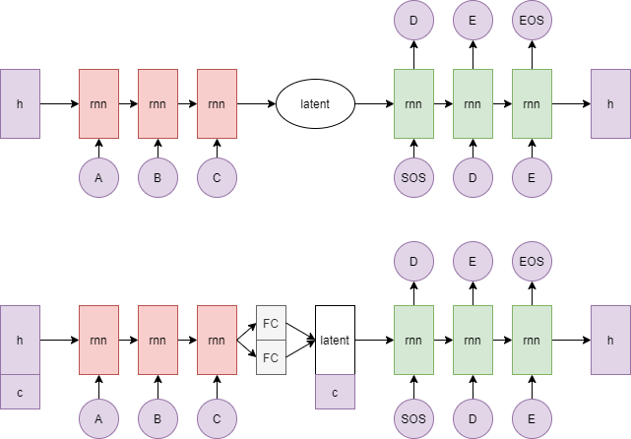
Lab Description - architecture

Slide 7
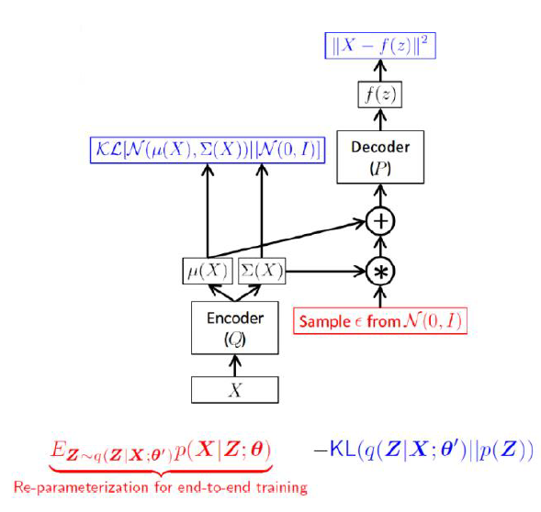
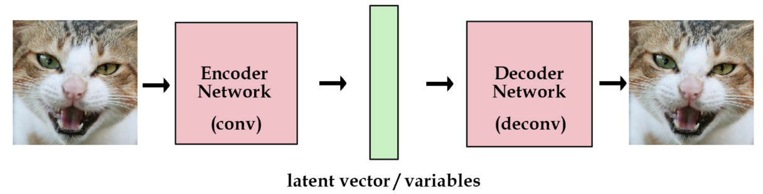
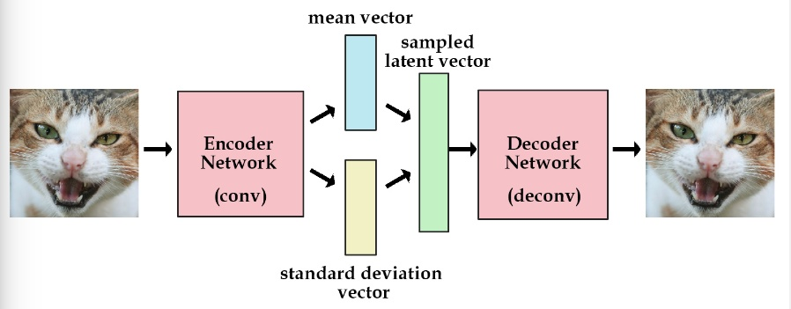
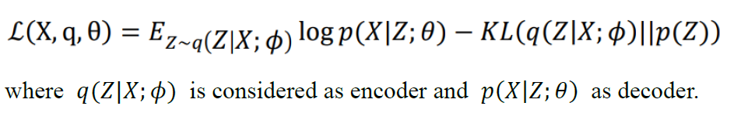
Lab Description - VAE
VAE objective: reconstruction and generation

Slide 8
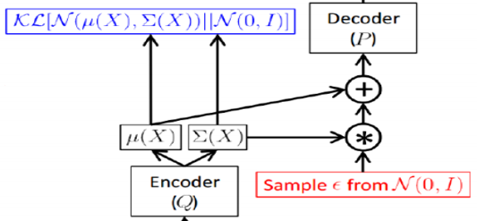
Lab Description - CVAE
Reparameterization trick
Log variance
Output should be log variance (not variance)
Condition
Simply concatenate to the hidden_0 and z
Embed your condition to high dimensional space (or simply use one-hot)

Slide 9
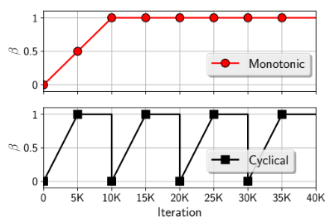
Lab Description - CVAE
KL cost annealing
Initially set your KL weight to 0
Maximum value is 1

Slide 10
Lab Description – Other details
The encoder and decoder must be implemented by LSTM.
You should not adopt attention mechanism
The loss function is nn.CrossEntropyLoss().
The optimizer is SGD
Adopt BLEU-4 score function in NLTK.
Average 10 testing scores
Adopt Gaussian_score() to compute the generation score
Random sample 100 noise to generate 100 words with 4 different tenses (totally 400 words)
4 words should exactly match the training data.

Slide 11
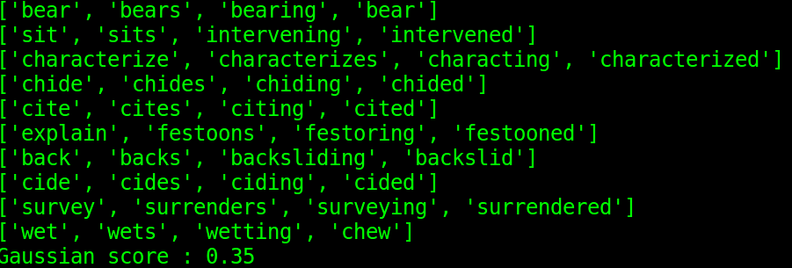
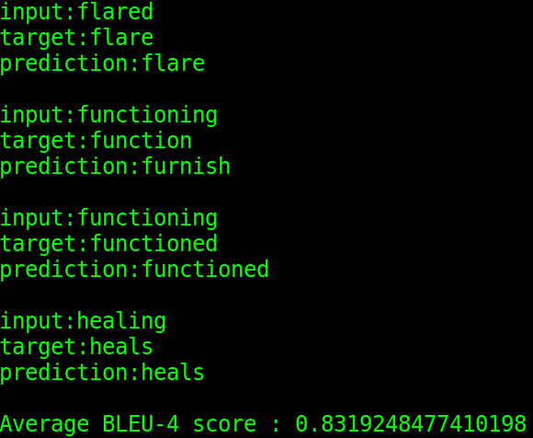
Lab Description – Requirements
Modify encoder, decoder, and training functions
Implement evaluation function, dataloader, and reparameterization trick.
Adopt teacher-forcing and kl loss annealing in your training processing.
Plot the crossentropy loss, KL loss, and BLEU-4 score curve during training.
Output examples (tense conversion & Gaussian noise with 4 tenses)

Slide 12
Hints
Training method
Input the word with the tense and the output should also be the same word.
Convert each character to a number (dictionary)
Model weights
Strongly recommend you save your model weights during training
Teacher forcing ratio and KL weight
Influential to the performance of model
You can first set your KL weight to 0 to see whether your model works.

Slide 13
Scoring Criteria
Report (50%)
Introduction(5%)
Derivation of CVAE(5%)
Implementation details(15%)
Describe how you implement your model. (e.g. dataloader, encoder, decoder, etc)
Specify the hyperparameters (KL weight, teacher forcing ratio, etc.)
Notice: You must prove that your text generation is produced by Gaussian noise (paste/screenshot your code)
Results and discussion(25%)
Plot the loss and KL loss curve while training and discuss the results. (5%)
Plot the BLEU-4 score of your testing data while training and discuss the result. (20%)
Notice: This part mainly focuses on your discussion, if you simply just paste your results, you will get a low score

Slide 14
Scoring Criteria
Demo(50%)
Capability of tense conversion on testing data. (20%)
score >= 0.7 ---- 100%
0.7 > score >= 0.6 ---- 90%
0.6 > score >= 0.4 ---- 80%
score < 0.4 ---- 0%
Capability of word generation. (Gaussian noise + tense) (10%)
score = Gaussian_score() (100 words with 4 tenses)
score >= 0.3 ---- 100%
0.3 > score >= 0.2 ---- 90%
0.2 > score >= 0.05 ---- 80%
Otherwise ---- 0%
Questions (20%)

Slide 15
Implement Hints
Sampling
torch.randn(*size)
ex : torch.randn(*size) * exp(0.5 * var) + mean
torch.randn_like(input)
Pytorch seq2seq tutorial
https://pytorch.org/tutorials/intermediate/seq2seq_translation_tutorial.html

